Slide 1
LC/NACO RDA Phase 3B
Gary L. Strawn
Northwestern University Library
mrsmith@northwestern.edu
Celebrating 21 years of machine-proposed authority records

Slide 2
Outline
Re-code remaining AACR2 records as RDA
1XX field NOT materially changed
At least 7.5 million records re-issued
All updated records re-issued at once
Additional changes

Slide 3
Additional changes
Replace obsolete indicators with space
Set 008/39 (record source) to correct value, based on 040 $a
Generate of 046 fields
368, 370-375 based on $c
ISNI

Slide 4
046 generation
Parse 670 fields for useful information
Fuller birth and death dates
Provision for some non-Gregorian calendars
Policy change: hyphens always used
Policy change: $2 'edtf' used if correct

Slide 5
046 example
046: : |f 1910-02-11 |g 2010-01-06 $2 edtf
100:1 : |a Hatto, A. T. |q (Arthur Thomas)
670: : |a Times online WWW site, Mar. 19, 2010 |b (Professor Arthur Hatto; b. Arthur Thomas Hatto, Feb. 11, 1910, London; d. Jan. 6, 2010)

Slide 6
Additional fields
368 $c, $d; 370-375
Based on text in subfield $c
Spreadsheet prepared by BL

Slide 7
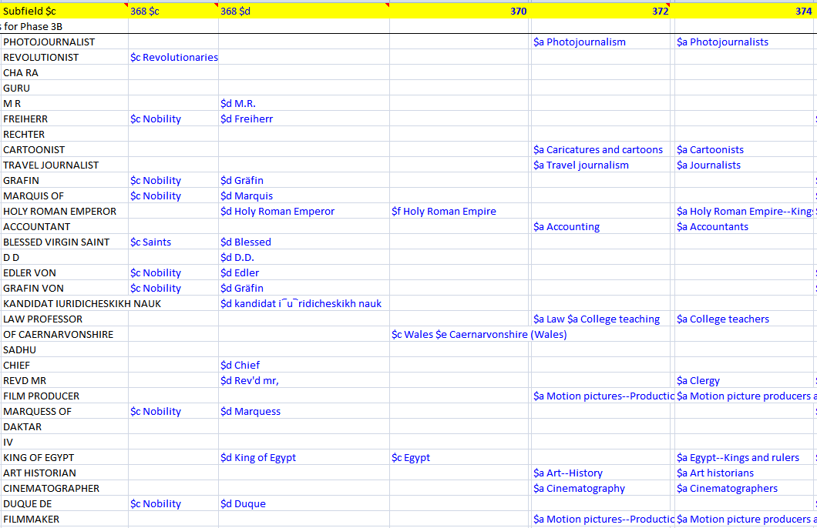

Slide 8
ISNI
Added in 024 field
Data for matches supplied by OCLC Europe
Will be maintained, by separate process

Slide 9
Schedule
Schedule not yet set
Work to be completed before end of September, 2015

Slide 10
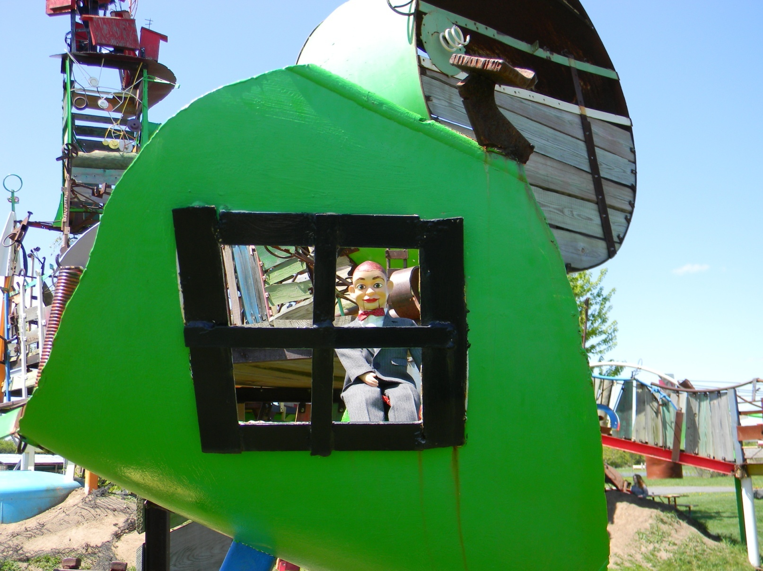
That’s all for now!

